Slide 1
Design the Future of HCT Societies: WBMT Perspective
Hildegard T. Greinix
Medical University Graz, Austria
President WBMT

Slide 2
WBMT Mission
Promoting excellence in HCT, stem cell donation, cellular therapy and accreditation as well as access to HCT worldwide through collaboration of existing international societies using coordination, communication and advocacy.
Engage exclusively in charitable, scientific, and educational activities and endeavors to encourage discussions and investigations related to HCT and cell therapy.
Focus of WBMT is to collaboratively advance the field of HCT and cell therapy.

Slide 3













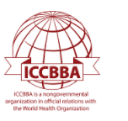








WBMT‘s 22 Member Organizations

Slide 4
Selected WBMT Activities
• Promote development of new HCT facilities, especially in countries with limited resources.
• Organize workshops in interested countries.
• Provide mentoring/educational options on individual basis.
• Promote quality and safety in all areas of HCT, stem cell donation and donor follow-up.
• Assist HCT programs in worldwide challenges.

Slide 5
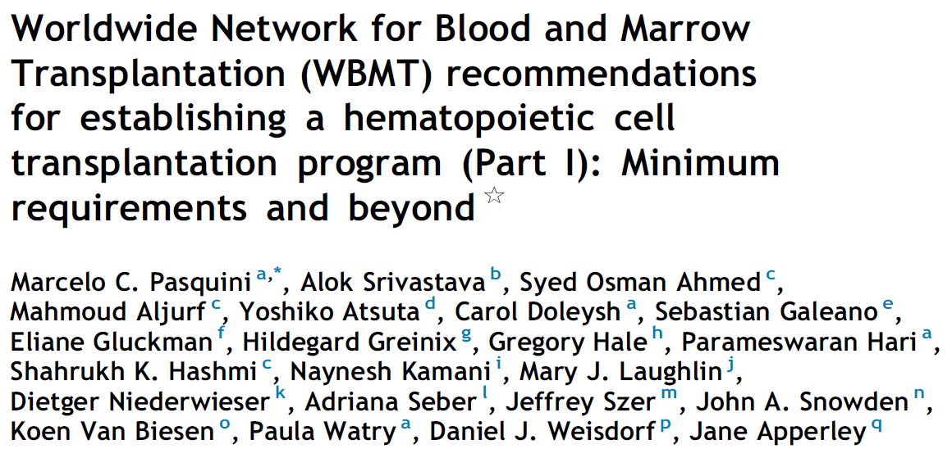
Hematol Oncol
Stem Cell Ther in press
Transplant Center and Recipient Issues Standing Committee for WBMT organized structured review of all pertinent elements to establish a transplant program.
Different domains: staff, cell processing lab, blood banking, lab, radiology, pharmacy, HLA testing, ancillary services, quality.
Independent reviewers score all elements for allo and auto HCT on 7-point scale.
Minimum requirements, preferred and ideal recommendations.

Slide 6
Definition of HCT Program Phases
 | Phase I Minimum | Phase II Preferred | Phase III Ideal
Types of transplant performed | ▪Autologous ▪ABO-matched HLA- matched sib donors | Phase I + ▪All MSD transplants ▪Autologous with cryopreserved products | Phase II + ▪Haploidentical ▪and/or MUD ▪and/or UCB ▪and/or T-cell depleted
Number of HCT | 5 Auto HCT/year 3-5 Allo HCT/year | 10 Auto HCT/year 5-10 Allo HCT/year | >10 Auto HCT/year >10 Allo HCT/year

Slide 7
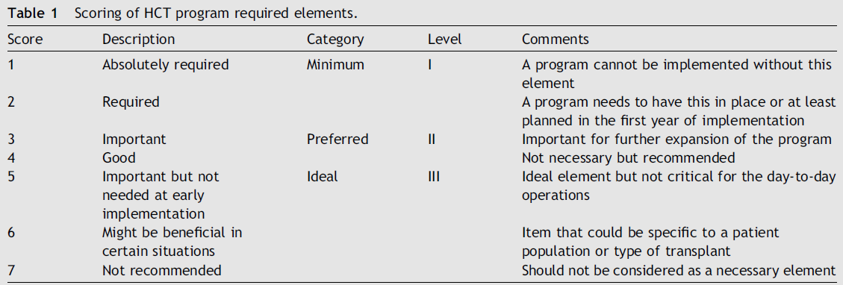
WBMT Recommendations for Establishing HCT Program
Pasquini MC et al. Hematol Oncol Stem Cell Ther in press

Slide 8
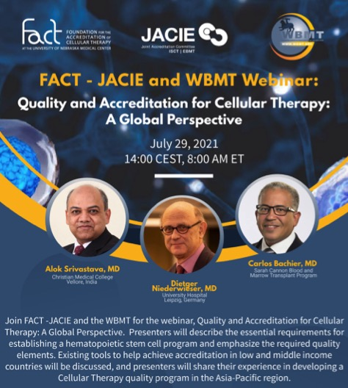
WBMT Webinars
Topic | Speaker function | Speaker
Introductions | Moderators | Joseph Schwartz & Eoin McGrath
Establishing a HSCT Program: Essential Requirements | WBMT representative | Dietger Niederwieser
Development of a Quality Program in the Asia-Pacific region | APBMT representative | Alok Srivastava
FACT/JACIE Accreditation in LMIC (step wise approach) | FACT/JACIE representative | Carlos Bachier
-Q&A | Moderators & Speakers

Slide 9
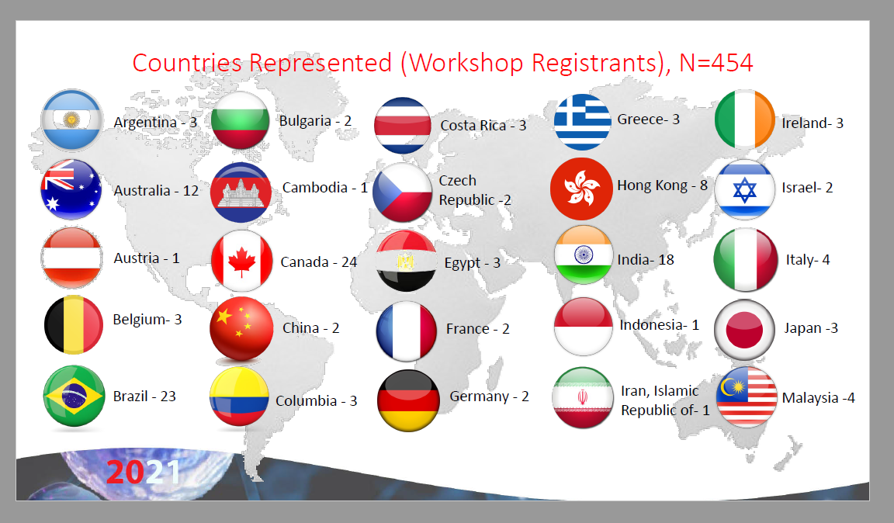
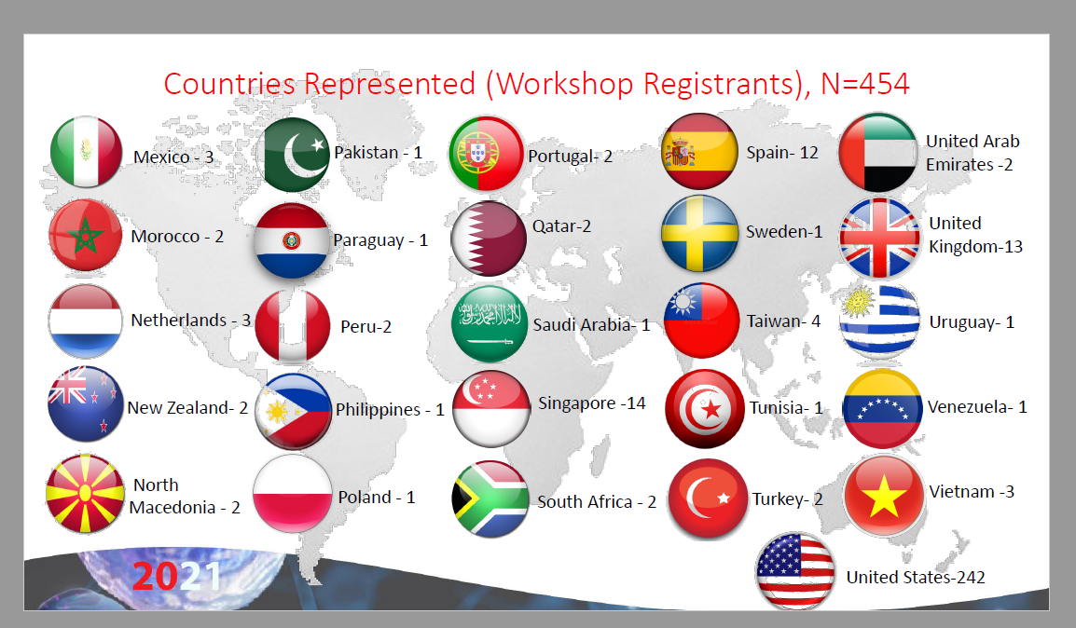
WBMT Webinar Attendees n=454

Slide 10
WHO Collaboration
Collaboration between WHO and WBMT contributes to the implementation of resolutions WHA57.18 and WHA63.22 on transplantation of human cells, tissues and organs
  Specific objective of supporting WHO‘s efforts towards improving access to and outcomes of allo HCT worldwide.
  Increase knowledge and understanding of current disease burden.
  Promote HCT as optimal treatment choice.
  Inform WHO in development of tools and guidance materials for strengthening national capacities.

Slide 11
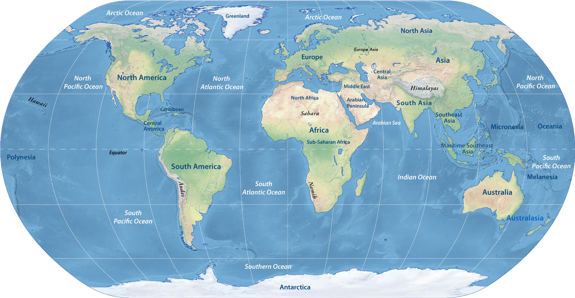
WBMT Workshops
Beijing, China
Hanoi, Vietnam
Salvador de Bahia,
Brazil
Islamabad,
Pakistan
Riyadh,
Saudi Arabia
Marrakesh, Marocco
Cape Town, South Africa

Slide 12
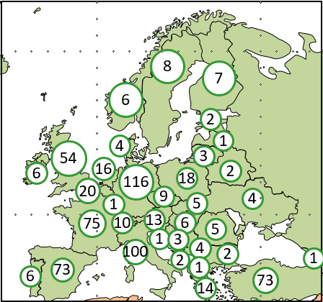

WBMT: maximum overall number of reporting teams per country:
1 848
Global Survey
1
8
7
17
26
6
2
54
16
4
3
1
6
20
116
9
18
2
4
75
1
13
5
1
1
10
1
6
5
198
100
3
4
2
1
1
6
73
2
1
73
1
1
14
2
114
45
381
2
10
2
1
3
2
3
2
7
3
1
18
13
1
2
67
3
1
3
11
3
2
3
3
2
1
1
6
13
5
The Americas
Eastern Mediterranean/Africa
Europe
South East Asia/Western Pacific
3
4
39
5
1
42
5
9
21
6

Slide 13
WBMT Global Survey: 2018
Worldwide Network for Blood and Marrow Transplantation
NGO in official relations with World Health Organization

Slide 14
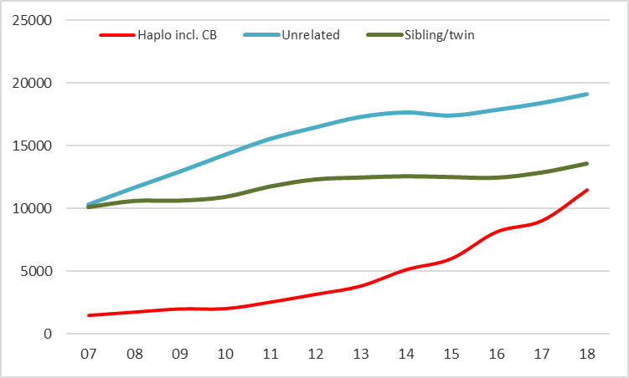
WBMT Global Survey: Trend 2007-2018 Donor type
Worldwide Network for Blood and Marrow Transplantation
NGO in official relations with World Health Organization

Slide 15
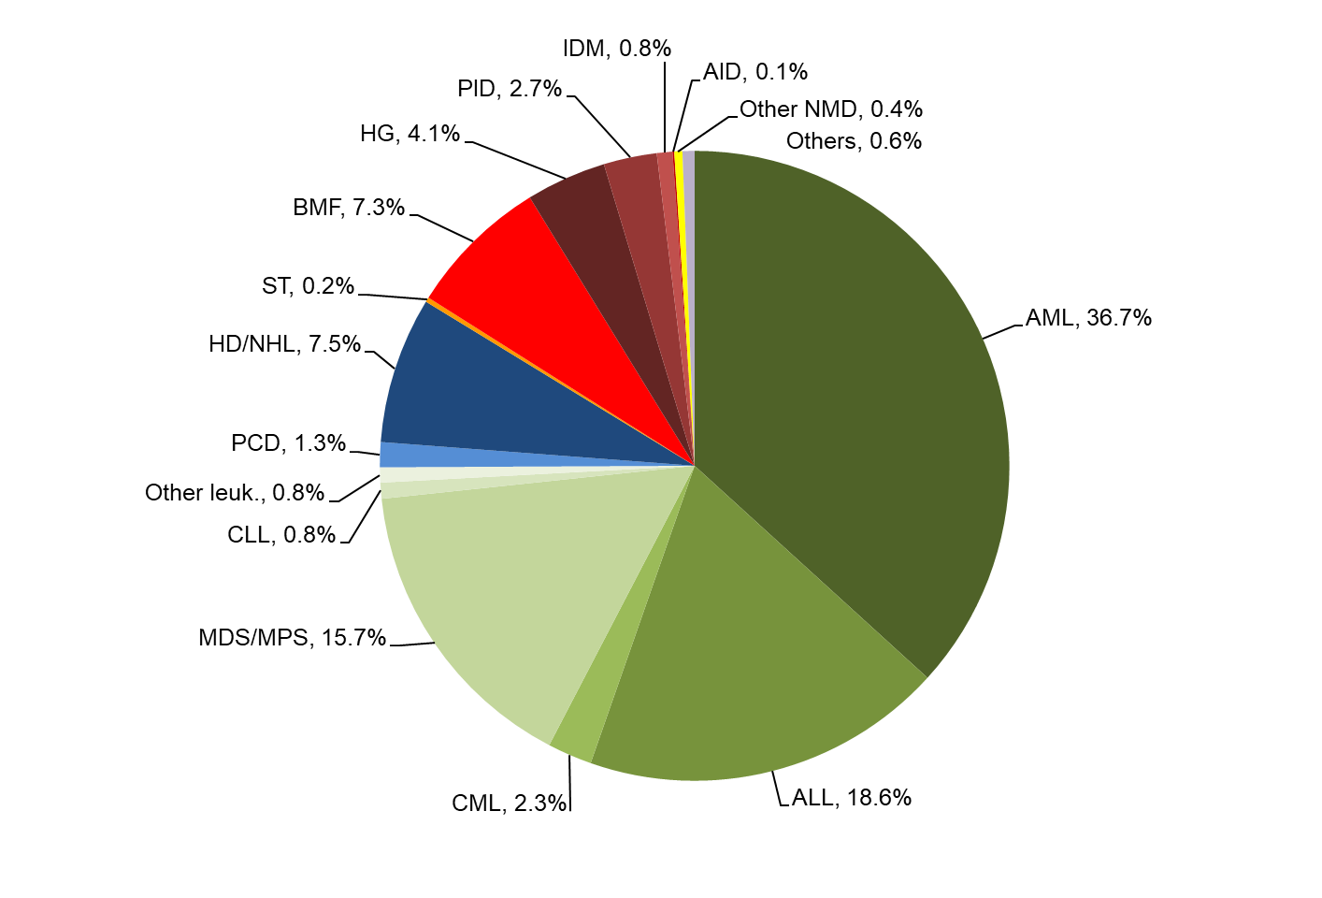
WBMT Global Survey: Main Diagnosis 2018: Allogeneic HCT
Worldwide Network for Blood and Marrow Transplantation
NGO in official relations with World Health Organization

Slide 16
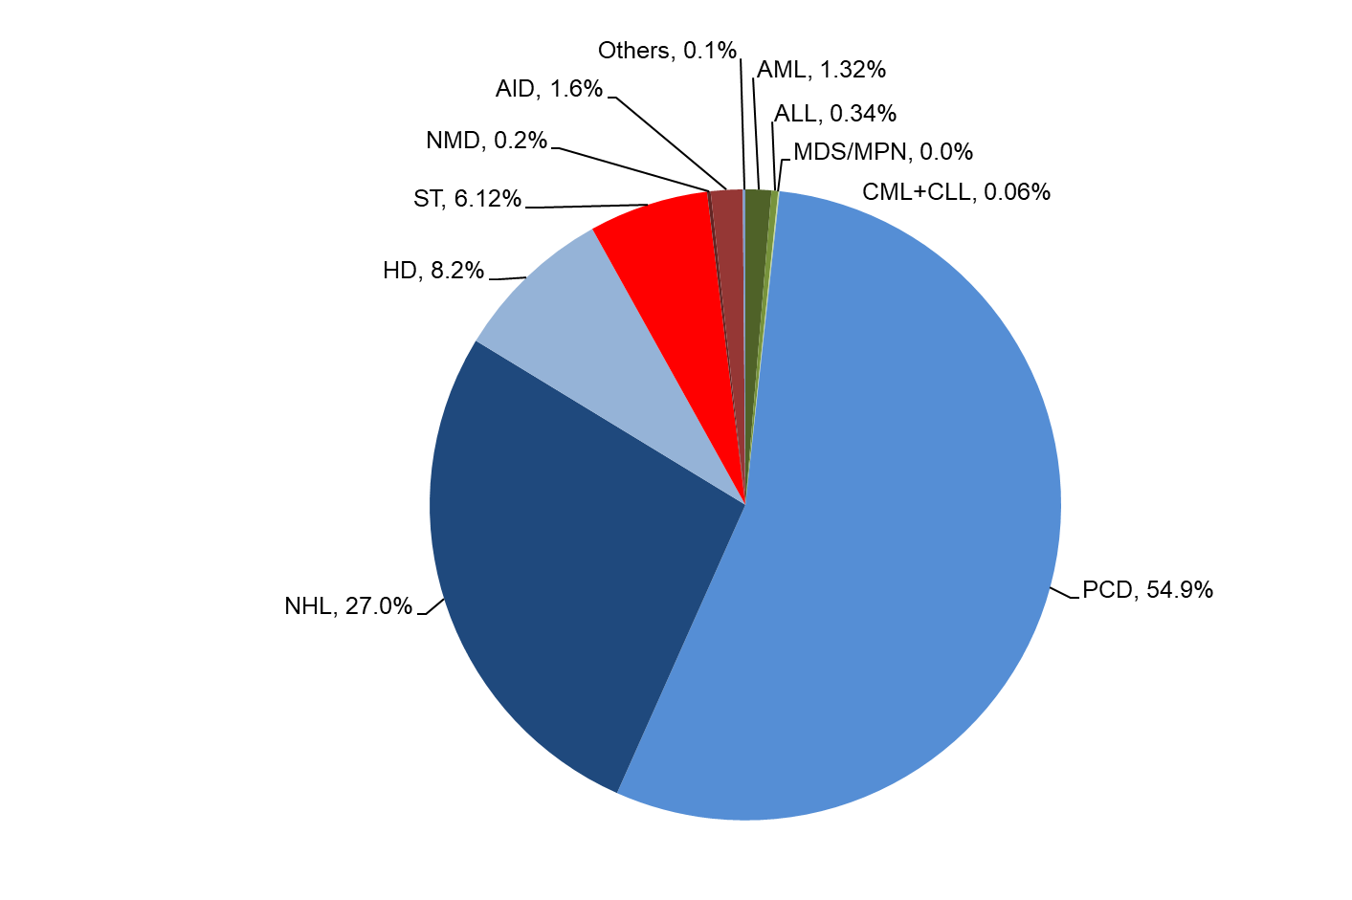
WBMT Global Survey: Main Diagnosis 2018: Autologous HCT
Worldwide Network for Blood and Marrow Transplantation
NGO in official relations with World Health Organization

Slide 17
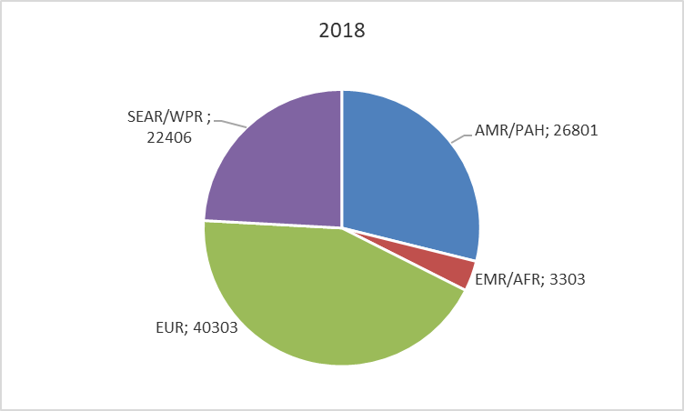
WBMT Global Survey:
All Transplants by Region 2018
Worldwide Network for Blood and Marrow Transplantation
NGO in official relations with World Health Organization

Slide 18
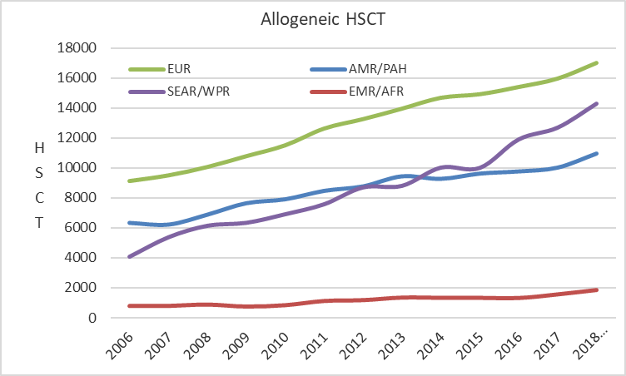
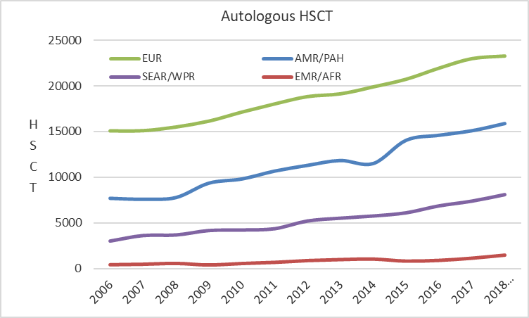
WBMT Global Survey:
HSCT by Region 2006-2018
Worldwide Network for Blood and Marrow Transplantation
NGO in official relations with World Health Organization

Slide 19
The Future of WBMT – Next 5 Years
LABMT outcome registry
AfBMT consolidation, outcome registry
Support LABMT, AfBMT and Asian countries to increase HCT activities
Foster training and education of all involved in HCT, stem cell donation and cellular therapies.
Increase diversity in patient advocacy/advisory standing committee

Slide 20
The Future of WBMT – > 5 Years
Promote excellence in HCT, stem cell donation, cellular therapy and accreditation as well as access to HCT worldwide.
Collaboratively advance the field of HCT and cell therapy.
  Altruistic, highly engaged colleagues and mentors interested in innovation, high quality and equal options
  Collaboration with national and international societies
  WHO collaboration
  Engage with care givers, policy makers and international organizations e.g. FDA, EMA

Slide 21
Acknowledgements
All member organizations
WHO: Efstratios Chatzixiros
Members of Executive Committee
All chairs and members of Standing Committees
WMDA: Lydia Foeken and Jitske Barneveld Binkhuysen

